Slide 1
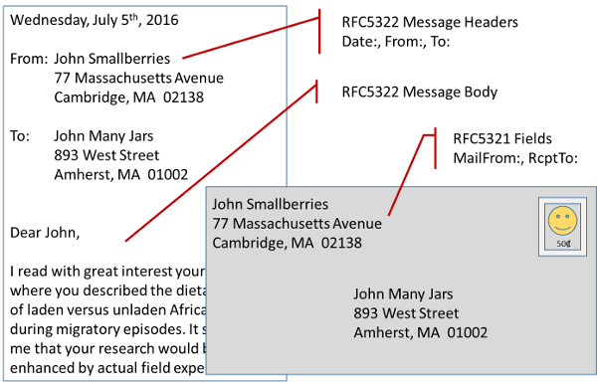
History of Email

Slide 2
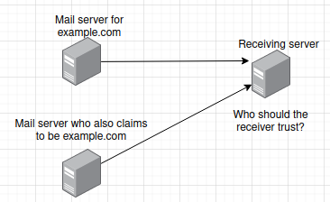
Setup a rival email server

Slide 3
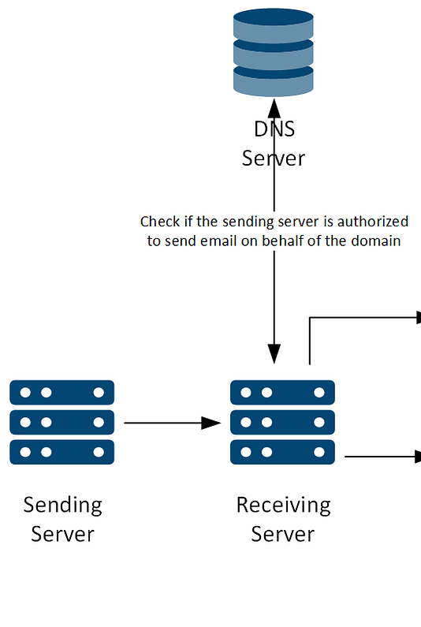
Sender Policy Framework

Slide 4
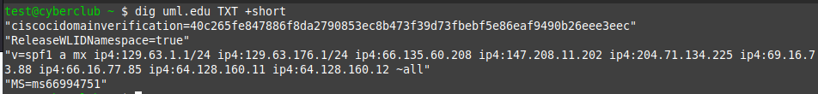
View SPF Record
Dig uml.edu TXT +short
nslookup -type=TXT domain.com

Slide 5
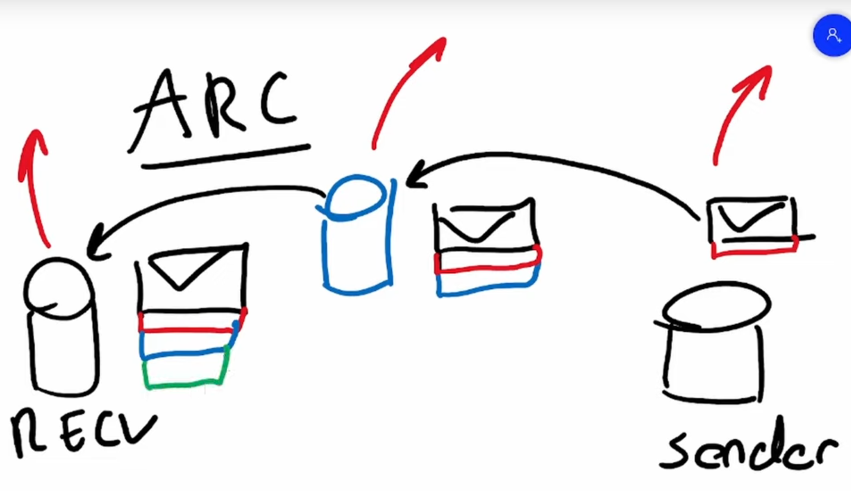
Authenticated Received Chain

Slide 6
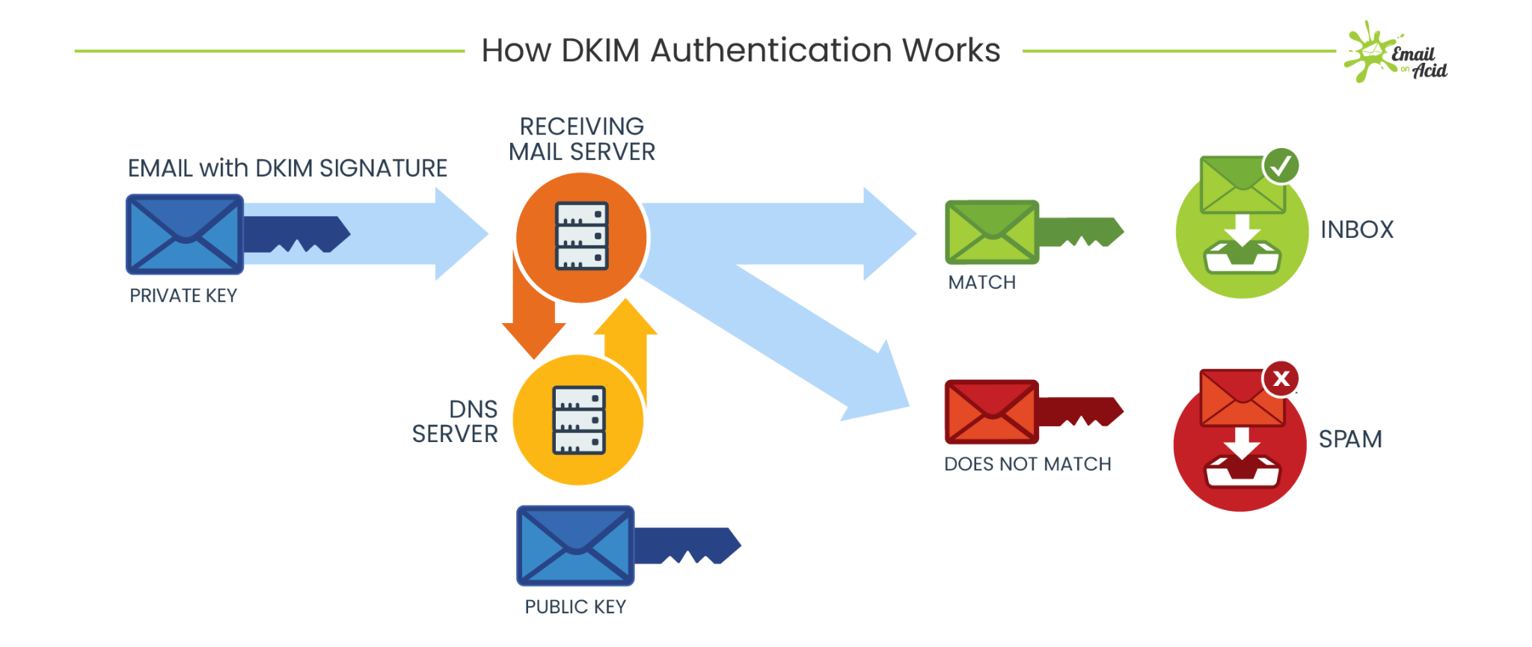
Domain Keys Identified Mail

Slide 7
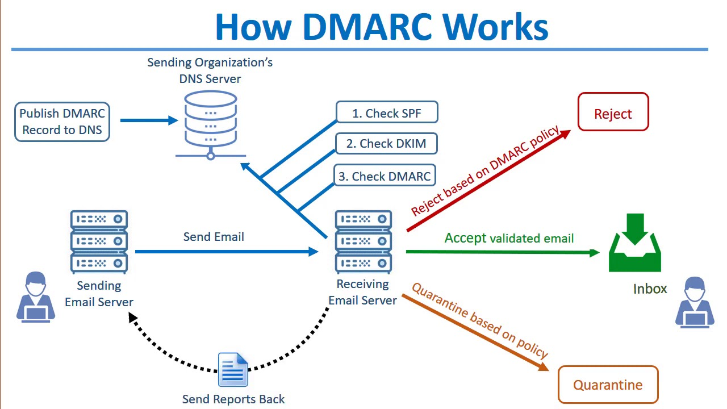
Domain-Based Message Authentication and Reporting

Slide 8
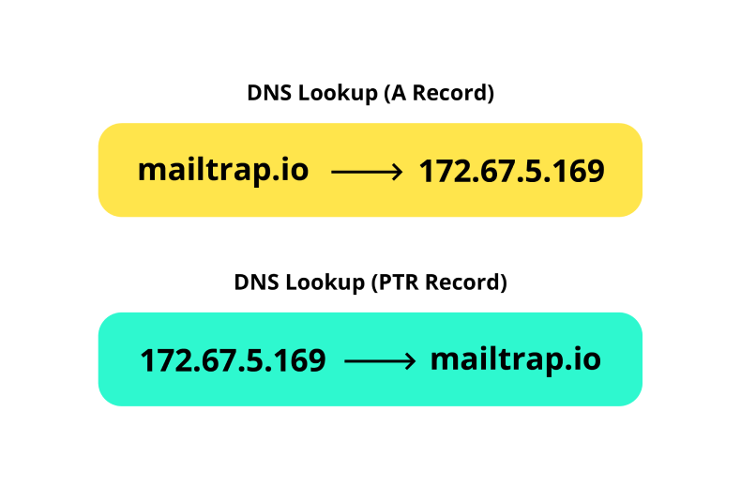
PTR Records

Slide 9
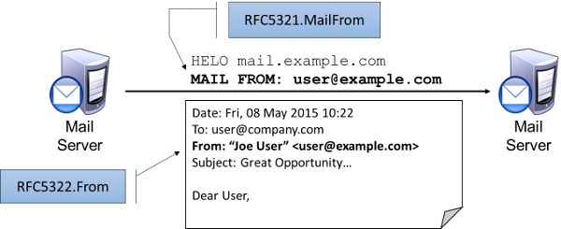
Inner “From” is displayed, not outer

Slide 10
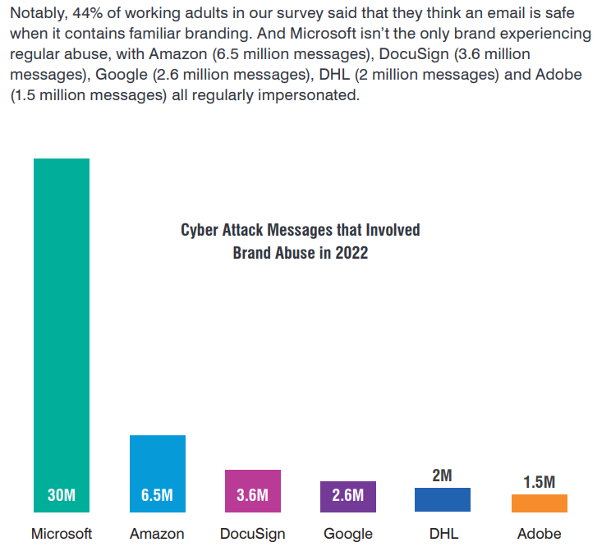

Slide 11

Lab 2: Spoof me an email
Internal email server, stay legal
Don’t use https://emkei.cz/
I will open your mail in a VM
Use the scenario

